Slide 1
7-1 INTRODUCTION
The Internet Protocol (IP) is the transmission mechanism used by the TCP/IP protocols at the network layer.
TCP/IP Protocol Suite

Slide 2
Which of the following is correct IPv4 address?
124.201.3.1.52
01.200.128.123
300.142.210.64
10110011.32.16.8
128.64.0.0
TCP/IP Protocol Suite

Slide 3
Which of the following is correct regarding Class B Address of IP address
Network bit – 14, Host bit –16
Network bit – 16, Host bit –14
Network bit – 18, Host bit – 16
Network bit – 12, Host bit –14
TCP/IP Protocol Suite

Slide 4
The last address of IP address represents
A. Unicast address
B. Network address
C. Broadcast address
D. None of above
TCP/IP Protocol Suite

Slide 5
Topics Discussed in the Section
Relationship of IP to the rest of the TCP/IP Suite
TCP/IP Protocol Suite

Slide 6
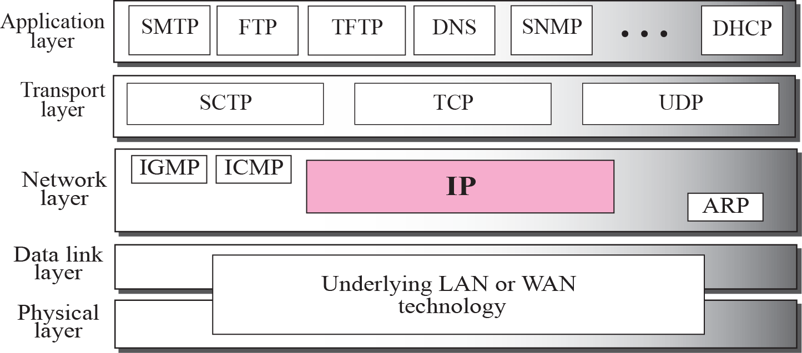
Figure 7.1 Position of IP in TCP/IP protocol suite
TCP/IP Protocol Suite

Slide 7
7-2 DATAGRAMS
Packets in the network (internet) layer are called datagrams. A datagram is a variable-length packet consisting of two parts: header and data. The header is 20 to 60 bytes in length and contains information essential to routing and delivery. It is customary in TCP/IP to show the header in 4-byte sections. A brief description of each field is in order.
TCP/IP Protocol Suite

Slide 8
Topics Discussed in the Section
Format of the datagram packet
Some examples
TCP/IP Protocol Suite

Slide 9
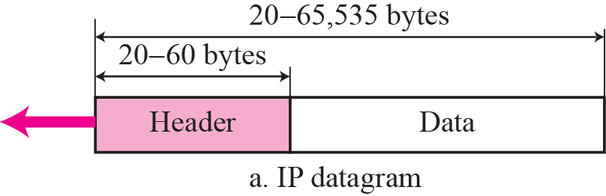
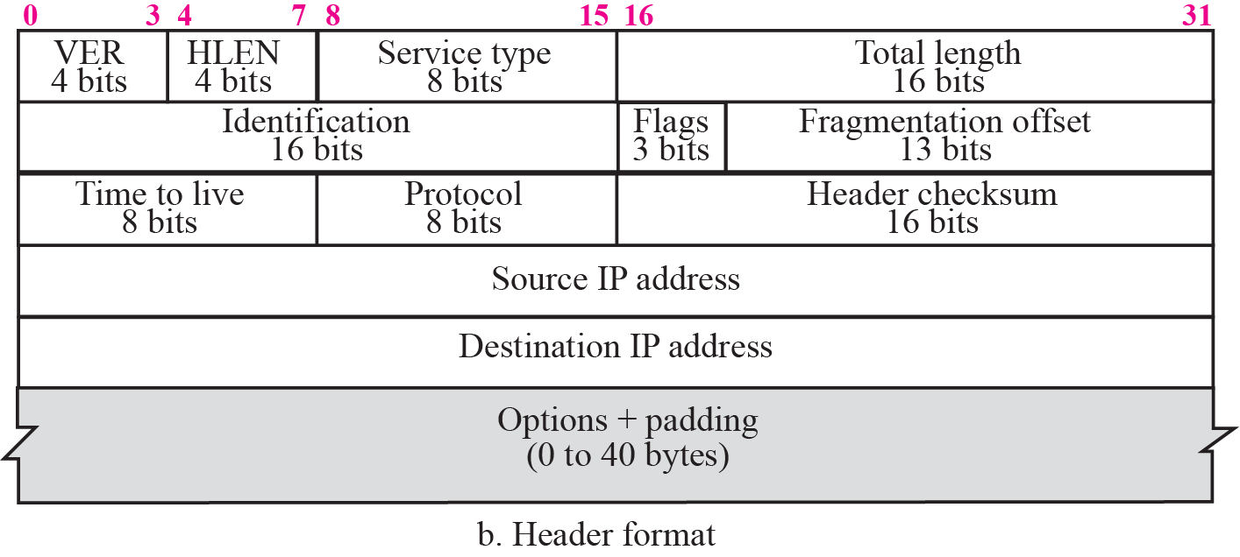
Figure 7.2 IP datagram
TCP/IP Protocol Suite

Slide 10

Figure 20.6 Service type or differentiated services
20.<number>

Slide 11

Table 20.1 Types of service
20.<number>

Slide 12

Note
The total length field defines the total length of the datagram including the header.
TCP/IP Protocol Suite

Slide 13

Figure 7.4 Encapsulation of a small datagram in an Ethernet frame
TCP/IP Protocol Suite

Slide 14
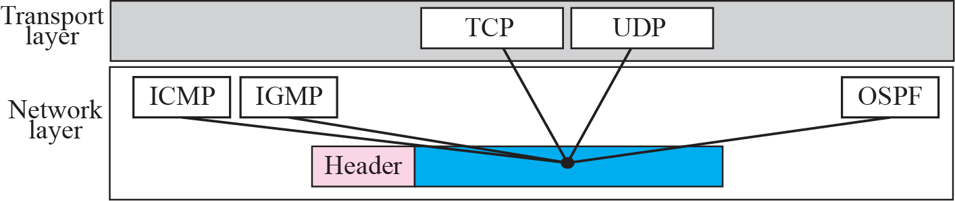
Figure 7.5 Multiplexing
TCP/IP Protocol Suite

Slide 15
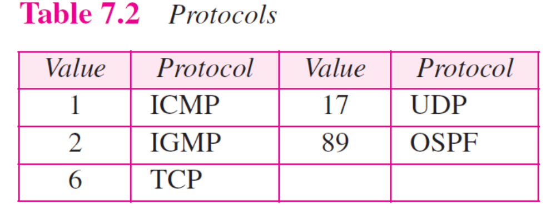
TCP/IP Protocol Suite

Slide 16

Example 7.1
An IP packet has arrived with the first 8 bits as shown:
The receiver discards the packet. Why?
TCP/IP Protocol Suite

Slide 17
Example 7.1
An IP packet has arrived with the first 8 bits as shown:
The receiver discards the packet. Why?
Solution
There is an error in this packet. The 4 left-most bits (0100) show the version, which is correct. The next 4 bits (0010) show the wrong header length (2 × 4 = 8). The minimum number of bytes in the header must be 20. The packet has been corrupted in transmission.
TCP/IP Protocol Suite

Slide 18
Example 7.2
In an IP packet, the value of HLEN is 1000 in binary. How many bytes of options are being carried by this packet?
TCP/IP Protocol Suite

Slide 19
Example 7.2
In an IP packet, the value of HLEN is 1000 in binary. How many bytes of options are being carried by this packet?
Solution
The HLEN value is 8, which means the total number of bytes in the header is 8 × 4 or 32 bytes. The first 20 bytes are the base header, the next 12 bytes are the options.
TCP/IP Protocol Suite

Slide 20
7-3 FRAGMENTATION
A datagram can travel through different networks. Each router decapsulates the IP datagram from the frame it receives, processes it, and then encapsulates it in another frame. The format and size of the received frame depend on the protocol used by the physical network through which the frame has just traveled. The format and size of the sent frame depend on the protocol used by the physical network through which the frame is going to travel.
TCP/IP Protocol Suite

Slide 21
Topics Discussed in the Section
Maximum Transfer Unit (MTU)
Fields Related to Fragmentation
TCP/IP Protocol Suite

Slide 22

Figure 7.6 MTU
TCP/IP Protocol Suite

Slide 23

Table 20.5 MTUs for some networks
20.<number>

Slide 24
Note
Only data in a datagram is fragmented.
TCP/IP Protocol Suite

Slide 25

Figure 7.7 Flags field
TCP/IP Protocol Suite

Slide 26
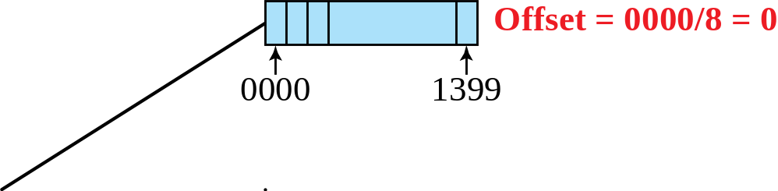
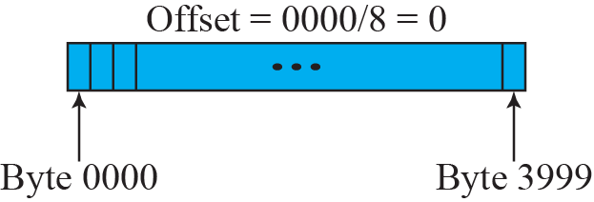
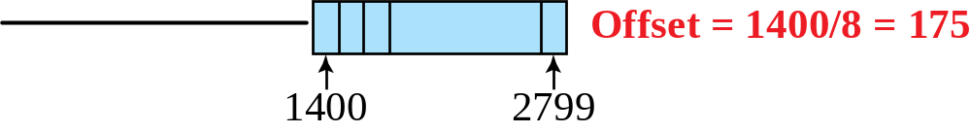
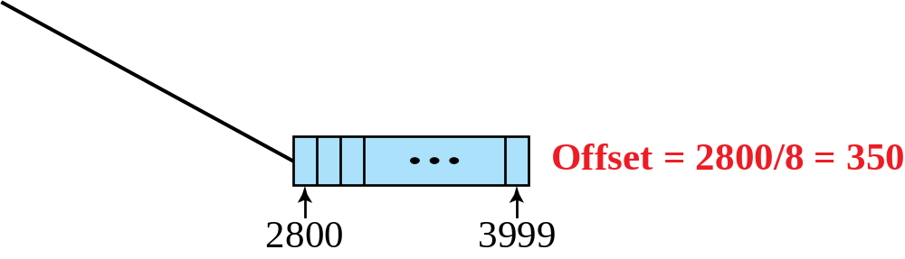
Figure 7.8 Fragmentation example
TCP/IP Protocol Suite

Slide 27
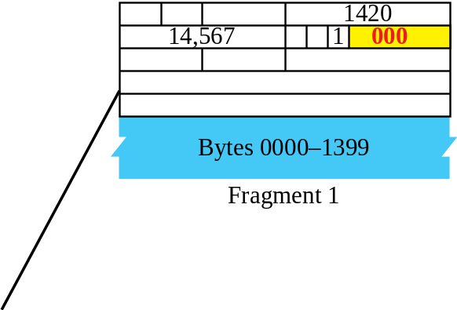
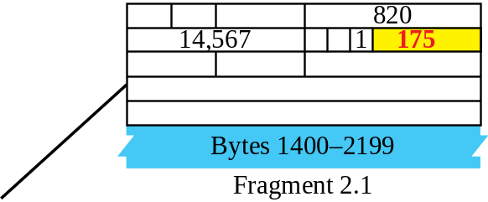
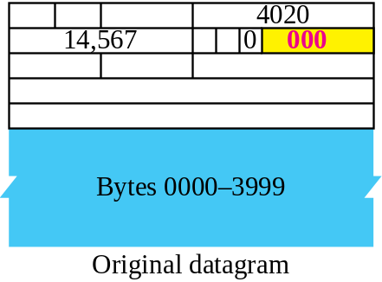
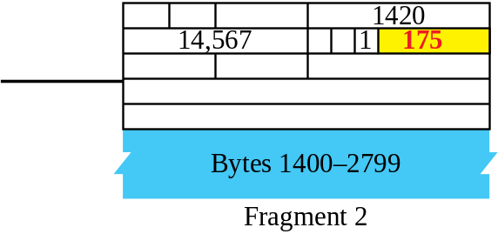
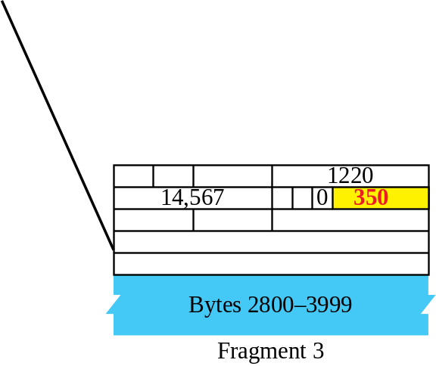
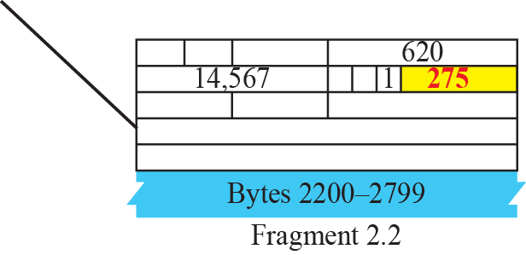
Figure 7.9 Detailed fragmentation example
TCP/IP Protocol Suite

Slide 28
Example 7.5
A packet has arrived with an M bit value of 0. Is this the first fragment, the last fragment, or a middle fragment? Do we know if the packet was fragmented?
Solution
TCP/IP Protocol Suite

Slide 29
Example 7.6
A packet has arrived with an M bit value of 1. Is this the first fragment, the last fragment, or a middle fragment? Do we know if the packet was fragmented?
Solution
TCP/IP Protocol Suite

Slide 30
Example 7.7
A packet has arrived with an M bit value of 1 and a fragmentation offset value of zero. Is this the first fragment, the last fragment, or a middle fragment?
Solution
TCP/IP Protocol Suite

Slide 31
Example 7.9
A packet has arrived in which the offset value is 100, the value of HLEN is 5 and the value of the total length field is 100. What is the number of the first byte and the last byte?
Solution
TCP/IP Protocol Suite

Slide 32
The first byte number is 100 × 8 = 800. The total length is 100 bytes and the header length is 20 bytes (5 × 4), which means that there are 80 bytes in this datagram. If the first byte number is 800, the last byte number must be 879.
TCP/IP Protocol Suite

Slide 33
7-4 OPTIONS
The header of the IP datagram is made of two parts: a fixed part and a variable part. The fixed part is 20 bytes long and was discussed in the previous section. The variable part comprises the options, which can be a maximum of 40 bytes.
Options, as the name implies, are not required for a datagram. They can be used for network testing and debugging. Although options are not a required part of the IP header, option processing is required of the IP software.
TCP/IP Protocol Suite

Slide 34
27-2 PACKET FORMAT
The IPv6 packet is shown in Figure 27.1. Each packet is composed of a mandatory base header followed by the payload. The payload consists of two parts: optional extension headers and data from an upper layer. The base header occupies 40 bytes, whereas the extension headers and data from the upper layer contain up to 65,535 bytes of information.
TCP/IP Protocol Suite

Slide 35
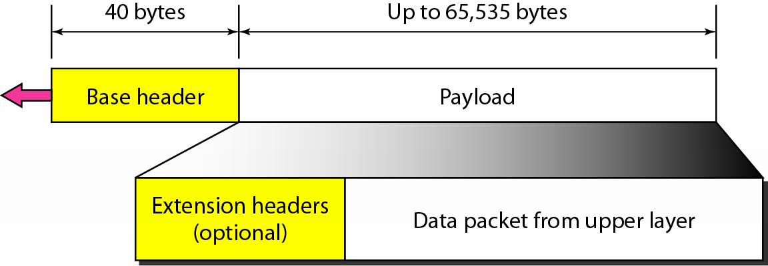
Figure 20.15 IPv6 datagram header and payload
20.<number>

Slide 36
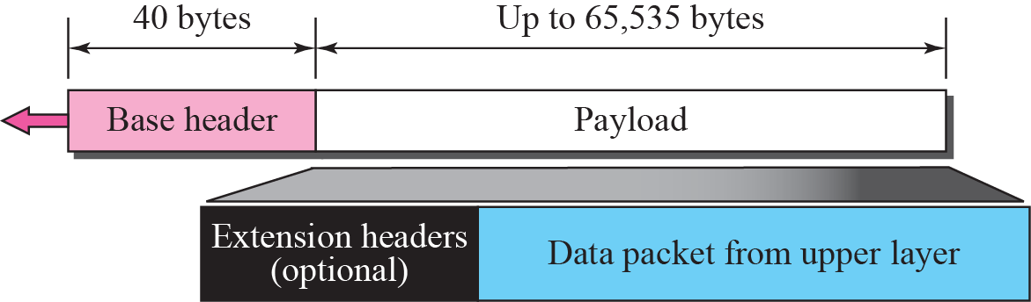
Figure 27.1 IPv6 datagram
TCP/IP Protocol Suite

Slide 37
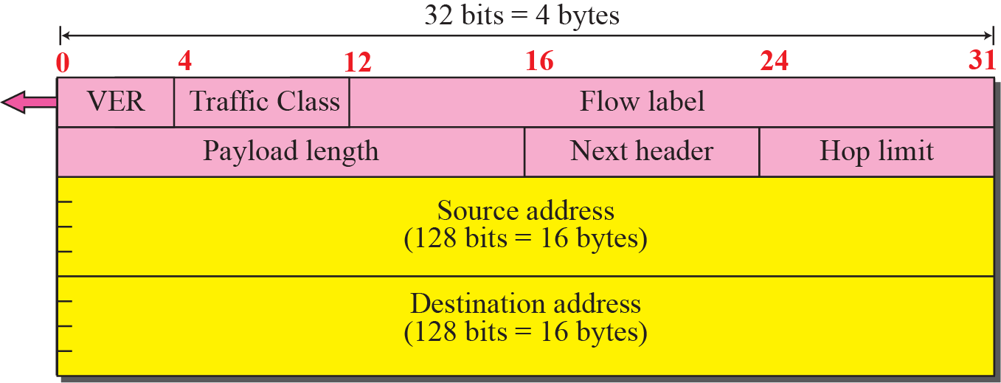
Figure 27.2 Format of the base header
TCP/IP Protocol Suite

Slide 38
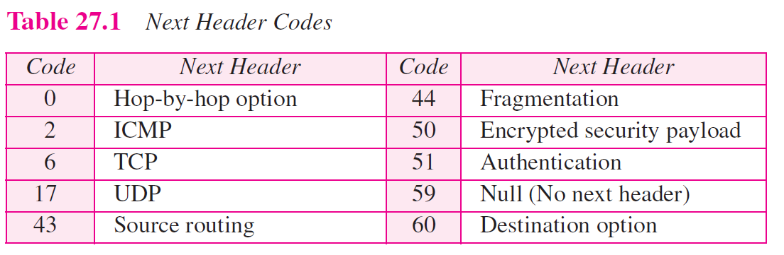
TCP/IP Protocol Suite

Slide 39
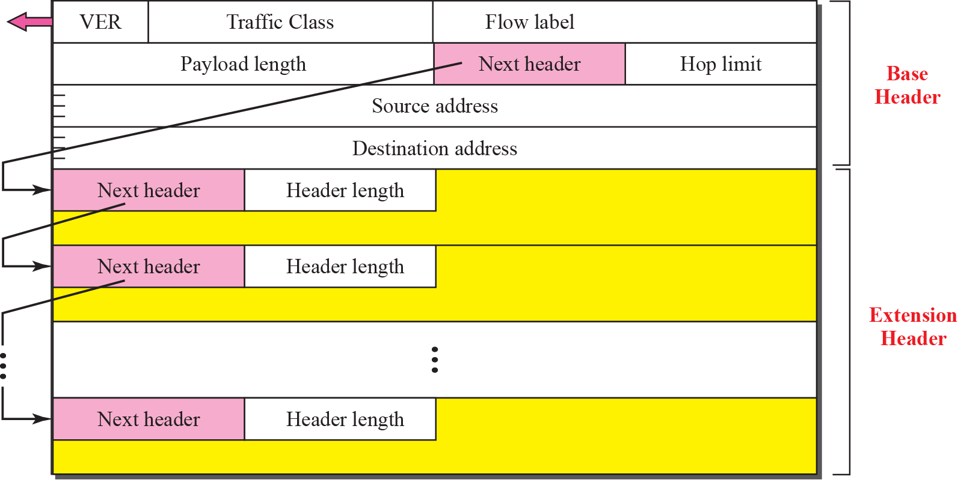
Figure 27.3 Extension header format
TCP/IP Protocol Suite

Slide 40
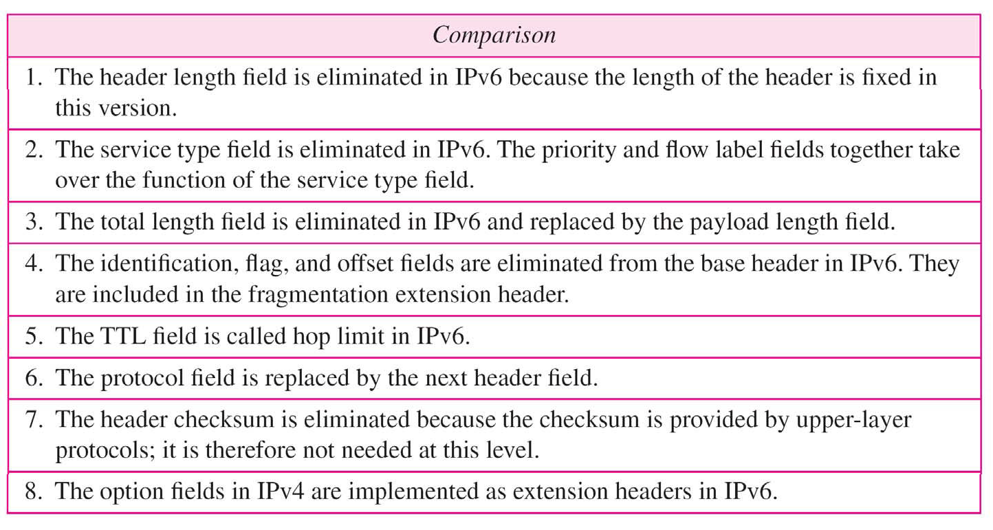
Table 20.9 Comparison between IPv4 and IPv6 packet headers
20.<number>

Slide 41

Figure 20.17 Extension header types
20.<number>

Slide 42
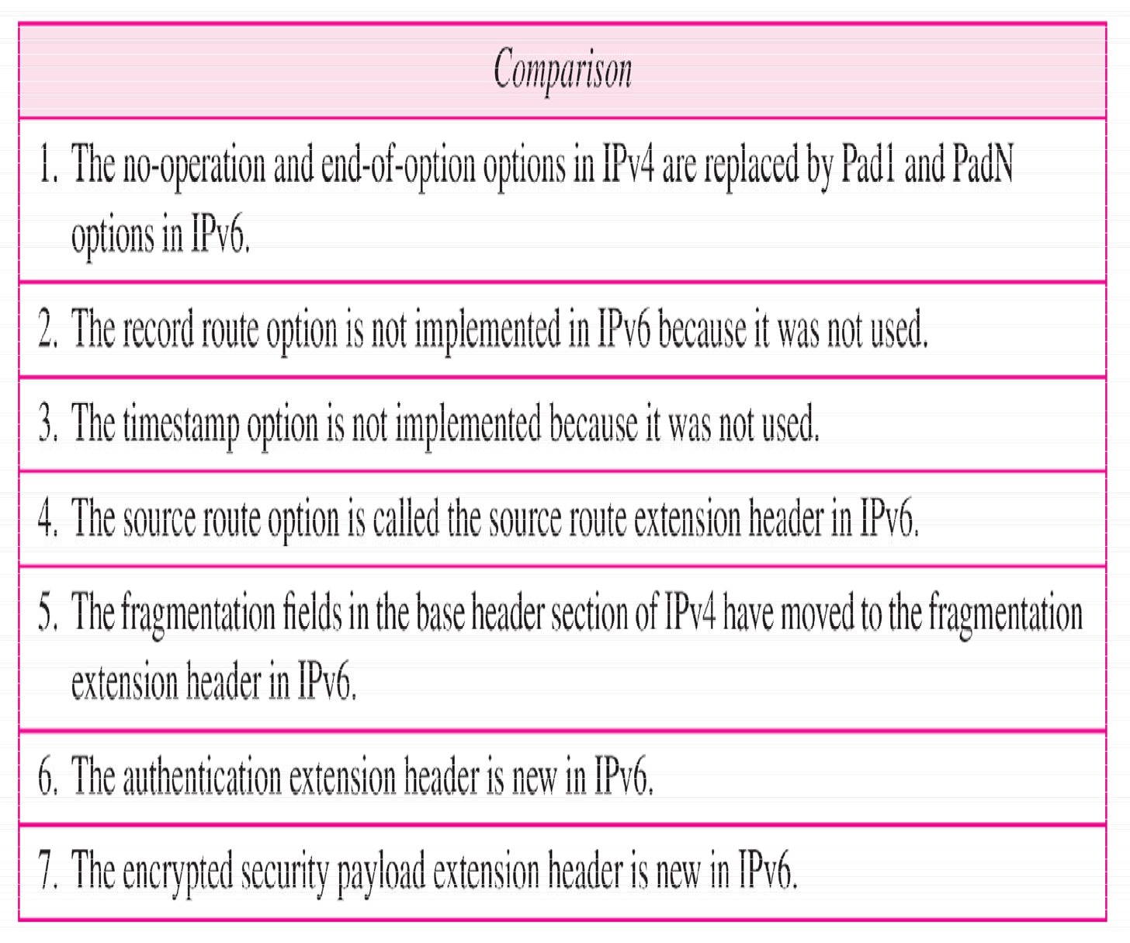
Table 20.10 Comparison between IPv4 options and IPv6 extension headers
20.<number>

Slide 43
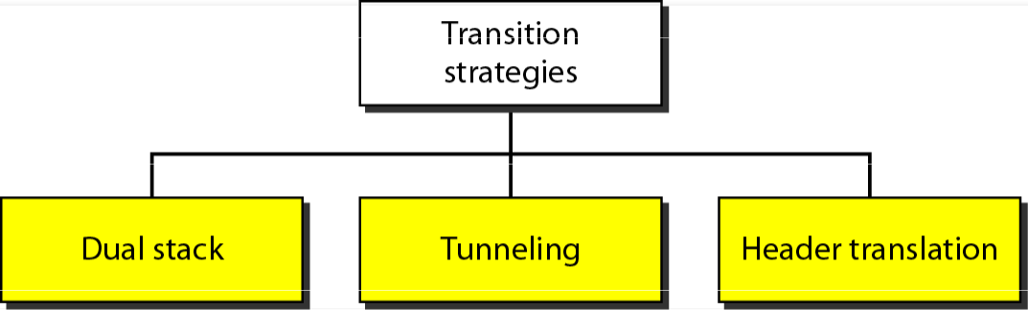
Transition from IPv4 to IPv6

Slide 44
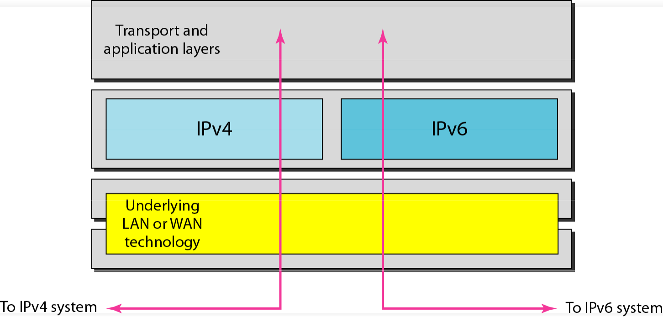
Figure 20.19 Dual stack
20.<number>

Slide 45
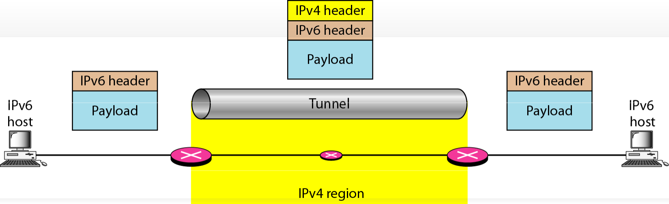
Figure 20.20 Tunneling strategy
20.50

Slide 46
